Slide 1


CherryGrade: Coffee Cherry Ripeness Classification to Reduce Harvest Losses for Nyeri’s Smallholder Farmers.
Mburu Margaret Wangari
KPSK-DeKUT-2-16
KIEP-SKIES
DeKUT

Slide 2
Background.
Smallholder farmers in Nyeri County lose 30–40% of their yields due to poor ripeness selection.
This results in KES 2,000+ lost per acre annually and 78% of harvests downgraded.
Visual sorting methods are subjective, inconsistent, and error-prone.
Lab-grade tools (costing over KES 5,000) are unaffordable for most farmers.
Climate variability makes ripeness timing even more unpredictable.
Existing Agri-tech focuses on soil health and pest control, not post-harvest quality.
There's a gap for affordable, AI-powered tools to support data-driven cherry grading.

Slide 3
Problem Statement.
Despite the economic potential of the specialty coffee market, smallholder farmers lack access to effective, scalable tools for objective ripeness assessment.
Manual grading is inconsistent and prone to error, resulting in lower yields, downgraded quality, and missed market opportunities.
Existing Agri-tech solutions do not solve the core problem of post-harvest quality detection, a task that requires not just precision, but real-time, field-ready intelligence.
There is a pressing need for a solution that demonstrate how computer vision and object detection can be applied in practical agricultural settings.

Slide 4
Solution.
CherryGrade is a computer vision-based tool that detects and classifies coffee cherry ripeness using object detection.
Built on the YOLOv8n model, trained to identify 5 stages: unripe, ripe, semi-dry, dry, overripe.
Users upload an image via a Flask-based interface; the system returns instant classification.
Provides actionable feedback to guide sorting or harvesting decisions.
Optimized with FP16 quantization and model caching for fast, lightweight deployment.
Useful as a learning tool for AI and agriculture, with real-world dataset and application.
Scalable for integration into Agri-robots, drones, or automated sorting stations.

Slide 5
Methodology.
Step | Details
1. Data Source | Kaggle dataset on coffee fruit maturity (https://www.kaggle.com/datasets/cienciacafeto/coffee-fruit-maturity)
2. Preprocessing | Resize to 640x640, augment (flip, hue/saturation shift, normalize pixels)
3. Model | YOLOv8n (nano) — lightweight and fast for web deployment
4. Training Setup | Split: 70% train, 20% validation, 10% test. Hyperparams: lr=0.01, batch=16, epochs=100
5. Evaluation | MAP@0.5, precision, recall, F1-score. Baseline: expert accuracy (~75%)
6. Deployment | Flask API with image upload endpoint, FP16 quantization, model caching.

Slide 6
About the Data.
The data is sourced from Kaggle as Version 1.0 – Cherries on plant, natural background. It contains images and segmentation masks where cherries are classified based on their ripeness level.
Label Distribution:
Unripe: 8,207 - Green cherries that are still immature. (Not ready for harvest.)
Ripe: 1,428 - Cherries that have matured properly (ready to be picked).
Semi-dry: 874 - Cherries that have started drying but are not completely dry.
Dry: 301 - Cherries that have dried significantly (possibly shriveled).
Overripe: 234 - Cherries that are past the ripe stage, overmature. (Can affect coffee quality negatively.)
Total Masks: 11,044
Dataset Split:
- Training: 70% (600 images) - Validation: 20% (174 images)
- Testing: 10% (85 images) - Total Images: 859

Slide 7
Work Plan.
Week | Phase | Key Activities
Week 1 | Data Preparation | Acquire dataset, clean and preprocess images, apply augmentations
Week 2 | Model Training | Train YOLOv8 model, configure training parameters, monitor training progress
Week 3 | Model Tuning & Evaluation | Fine-tune hyperparameters, evaluate performance using mAP@0.5, precision, recall
Week 4 | Deployment | Build and optimize Flask API, integrate with web interface, field testing.

Slide 8
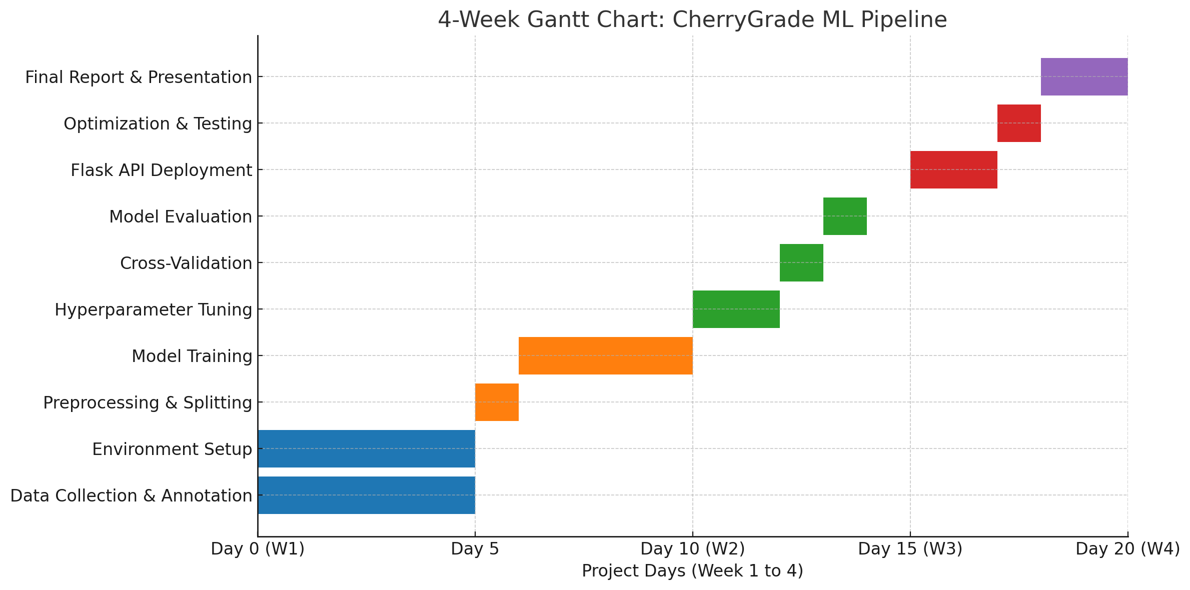
Timeline

Slide 9

Thank you!

